Slide 1
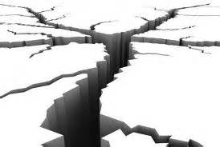
Earthquakes!
What causes Earthquakes?

Slide 2
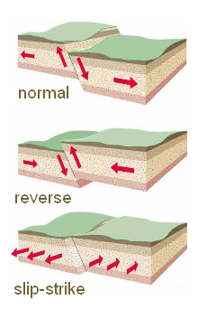
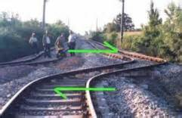
Review: Faults
Breaks in rock
Normal, reverse & slip-strike
Stresses – forces that act on rock
Slow movement causes deformations in Earth’s crust
Rocks along both sides of a fault usually tightly pressed together
Earthquakes common along faults

Slide 3
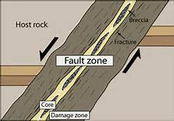
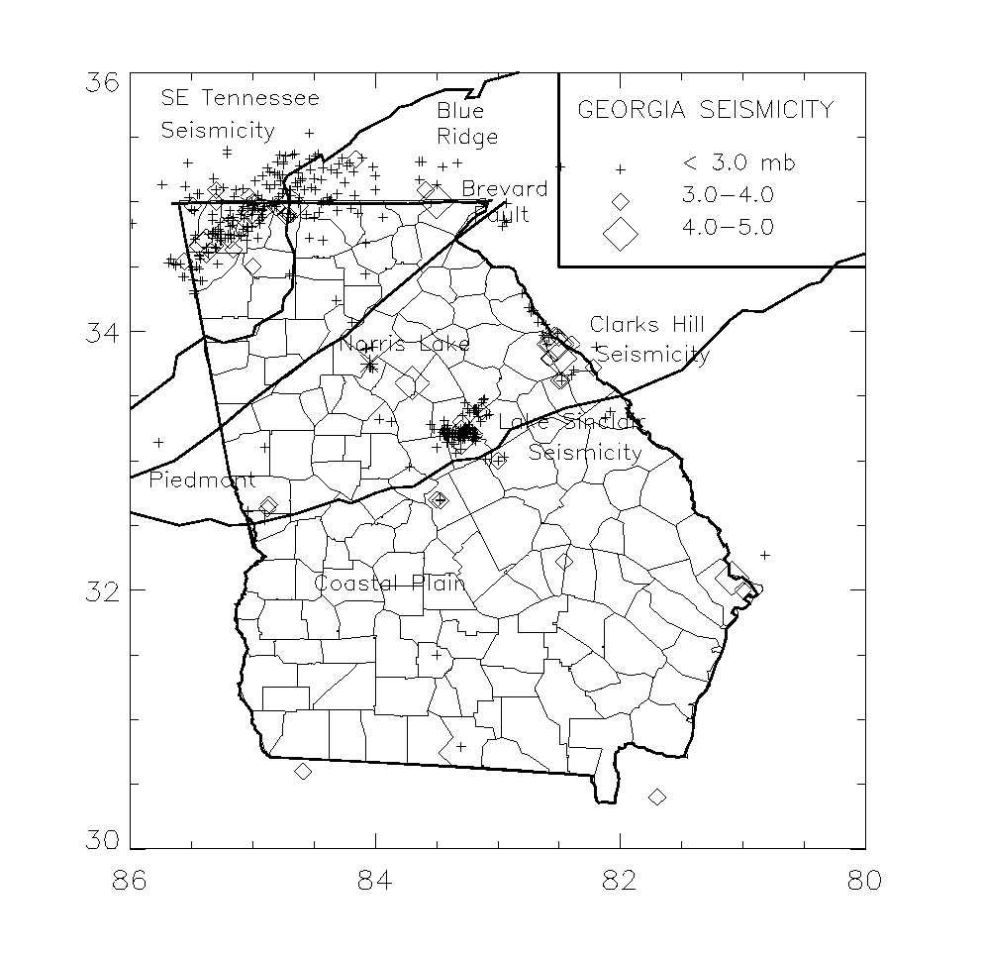
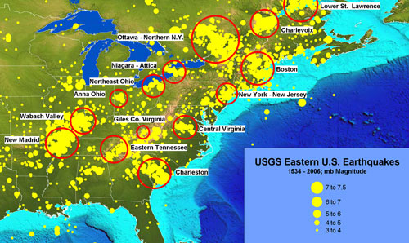
Fault Zones
Regions of numerous, closely spaced faults
Some fault zones ancient - less stress, less active
Ancient faults in Georgia - average 1, mag 4+ quake every 10 years

Slide 4
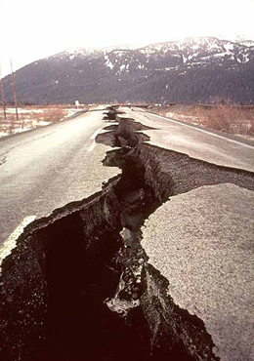
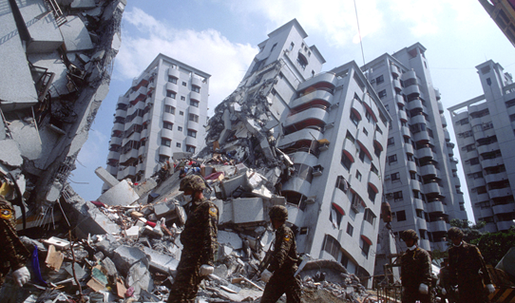
What are Earthquakes?
Destructive natural disaster
Movement of the ground
Usually along a fault line
Caused by sudden release of energy
Rocks under stress suddenly shift
Blocks of Earth move in earthquake along faults

Slide 5
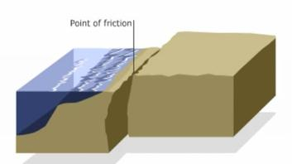
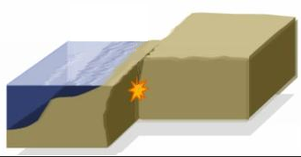
Locked Rocks
Rocks along fault locked by friction
Lock prevents rocks from moving past each other
Stress in locked rock increases
When stress goes past the where rocks can maintain their integrity - they fracture
Stress increases, rocks along fault move, trembling & vibrations result – earthquake!
When rocks slip into new positions energy released

Slide 6
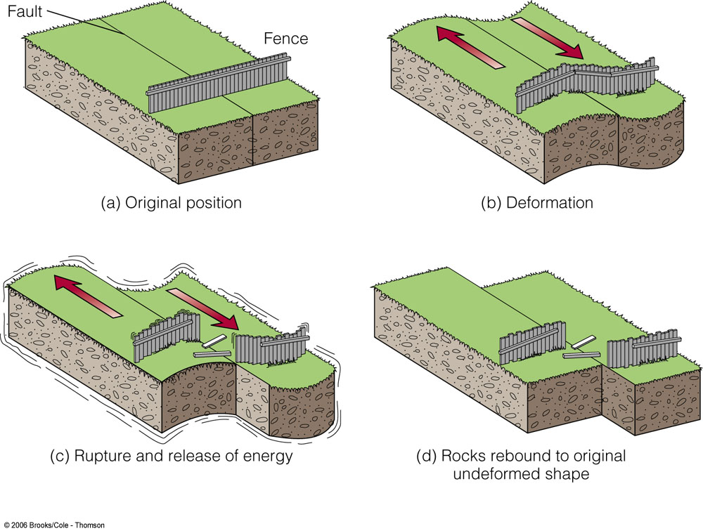
Elastic Rebound
Sudden return of rock to undeformed shape
Rock under stress deforms, fractures
Separate at weakest point then rebounds
Rebound results in earthquake as rock fractures, then rebounds and springs back to original shape
ANIMATION LINK

Slide 7
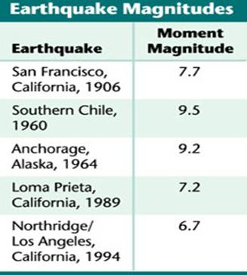
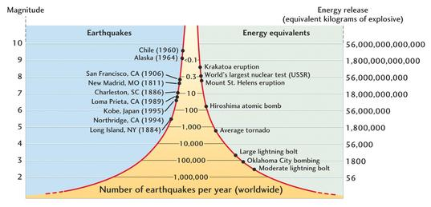
Earthquake Magnitude
Energy increases by factor of 30 for each increment on scale
Magnitude:
Measures the strength
Related to energy released
Richter scale:
Older system
Used in 20th century
Based on ground motion
Moment Magnitude Scale
New system
More accurate
Based on:
size of the area of the fault that moves
average distance that the fault block moves
rigidity of the rocks in the fault zone

Slide 8
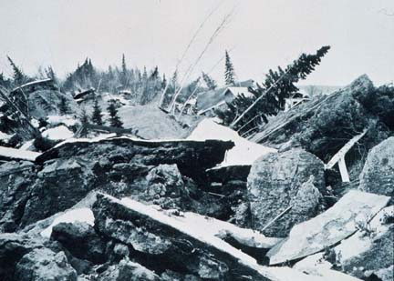
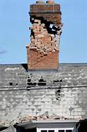
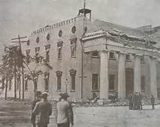
Activity: what does an Earthquake feel like?
Data Puzzle:
August 10, 1884
Earthquake hits northeastern US
Before seismographs
How could newspaper stories be used to provide information about the magnitude and epicenter of the earthquake?
What evidence is provided in newspaper accounts?

Slide 9
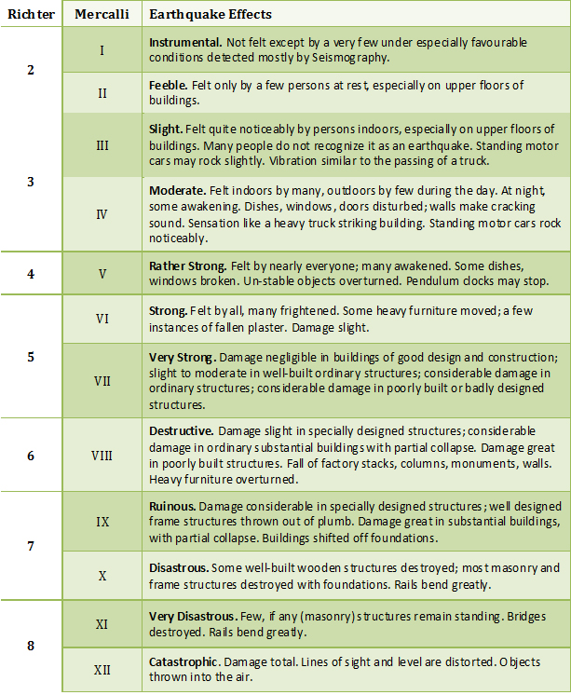
Earthquake intensity
Intensity: the amount of damage caused by an earthquake
Depends on:
Magnitude
Distance from epicenter
Local geology
Infrastructure
Mercalli Scale:
Measurement system
Describes the effects
Expresses intensity in Roman numerals

Slide 10
Task
Read articles with partners
Identify evidence
Note what is NOT in articles
Complete Data Table
Determine Modified Mercalli (MM) intensity
Use evidence from articles to determine
Come to group consensus
Be prepared to defend!

Slide 11
MODIFIED MERCALLI SCALE
MM I. Not felt, or rarely under especially favorable circumstances.
MM II. Felt indoors, especially on upper floors. Sometimes hanging objects may swing, especially when delicately suspended. Sometimes doors may swing very slowly. Sometimes dizziness or nausea is experienced.
MM III. Felt indoors by several people. Sometimes not recognized to be an earthquake at first. Duration estimated in some cases. Motion usually consists of rapid vibration, similar to the vibration of passing of light trucks. Hanging objects may swing slightly. Movement may be appreciable on upper levels of tall structures.
MM IV. Felt indoors by many, outdoors by few. Awakened some, especially light sleepers. Frightened those apprehensive from previous experience. Vibration like that due to passing of heavily loaded trucks. Rattling of dishes, windows, doors; glassware and crockery clink and clash. Creaking of walls. In numerous instances, hanging objects swing. Liquids in open vessels disturbed slightly.
MM V. Felt indoors by practically everyone, outdoors by many or most. Awakened most. Frightened few—a few ran outdoors. Buildings trembled throughout. Broke some dishes, glassware. Cracked windows (in some cases, but not generally). Overturned small or unstable objects. Hanging objects and doors swing generally or considerably. Knocked pictures against walls, or swung them out of place. Opened or closed doors and shutters abruptly. Moved small objects and furniture (the latter to slight extent). Spilled liquids in small amounts from well-filled open containers.
MM VI. Felt by all, indoors and outdoors. Frightened many, excitement general, some alarm, many ran outdoors. Awakened all sleepers. Liquid set in strong motion. Small bells rang, for example, in church, chapel, or school. Damage slight in poorly built buildings. Fall of plaster in small amount. Plaster cracked somewhat, especially fine cracks in chimneys. Broke dishes and glassware in considerable quantity; also some windows. Fall of knickknacks, books, and pictures. Overturned furniture in many instances. Moved moderately heavy furniture.
MM VII. Frightened all. General alarm; all ran outdoors. Some found it difficult to stand. Waves occurred on ponds, lakes, and running water. Damage slight to moderate in well-built ordinary buildings. Cracked chimneys to considerable extent, walls to some extent. Fall of plaster in considerable to large amounts; also some stucco. Broke numerous windows. Broke weak chimneys at the roofline. Dislodged bricks and stones. Overturned heavy furniture, with damage to furniture.
MM VIII. Fright general. Alarm approaches panic. Trees shaken strongly— branches and trunks broken off. Damage slight in structures built especially to withstand earthquakes. Considerable damage in ordinary substantial buildings. Fall of walls. Twisting and fall of chimneys, columns, and monuments. Very heavy furniture overturned.
MM IX to X. Panic general. Cracked ground up to widths of several inches; fissures up to a yard in width run parallel to canal and stream banks. Landslides considerable from river banks and steep coasts. Damage serious to dams, dikes, and embankments. Severe damage to well-built wooden structures and bridges: some collapse in large part; frame buildings completely shifted off foundations; dangerous cracks in excellent brick walls. Serious damage to reservoirs; underground pipes sometimes broken.
MM XI to XII. Damage total. Practically all works of construction damaged greatly or destroyed. Broad fissures, earth slumps, and landslides; fall of rocks of significant character; slumping of river banks, numerous and extensive. Fault slips in firm rock, with notable horizontal and vertical offset displacements.

Slide 12
Now the following groups will meet and compare their results.. Defend Your Answer!
Group A with Group 1
Group B with Group 2
Group C with Group 3
Group D with Group 4
Group E with Group 5
Group F with Group 6

Slide 13
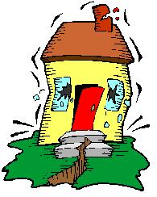
Part III: Engineering Experiment
Because earthquakes can cause walls to crack, foundations to move and even entire buildings to crumple, engineers incorporate into their structural designs techniques that withstand damage from earthquake forces, for example, cross bracing, large bases and tapered geometry. Earthquake-proof buildings are intended to bend and sway with the motion of earthquakes, or are isolated from the movement by sliders. Engineers come up with an idea, test it, and then re-engineer the structure based on its performance.

Slide 14
Your Task:
Your Group will have only toothpicks and 30 marshmallows to assemble an earthquake resilient structure. You may only use these supplies.
You may break toothpicks in half as you need them
You may use “cross bracing” to reinforce your structures
Buildings must be at least two toothpick levels high
Buildings must contain at least one triangle and one square
*You must draw your structure out on a
piece of paper and record your observations
after the first test..
*Redesign it and explain why you chose to
modify it as you did..
*List at least five factors that are important when
designing a structure in an earthquake prone
area.

Slide 15
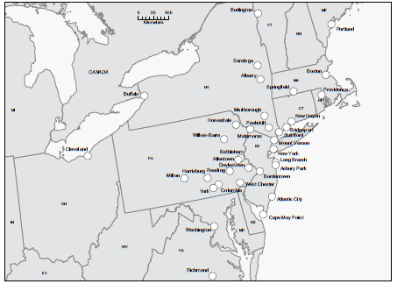
Sharing Group Results
As a class decide on each locations intensity & find the epicenter!

Slide 16
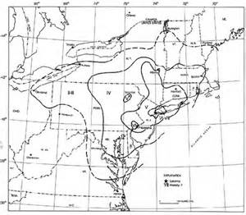
Debriefing….
How do these newspaper stories differ from current day stories?
What evidence was most helpful in determining intensity?
How did development of an intensity scale help geologists learn more about earthquakes?
Why did some locations close together seem to experience effects differently?
The map to the right is from a professional paper about this earthquake. How does it compare to ours?
How are magnitude and intensity different?

Slide 17
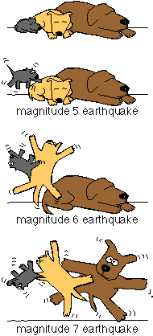
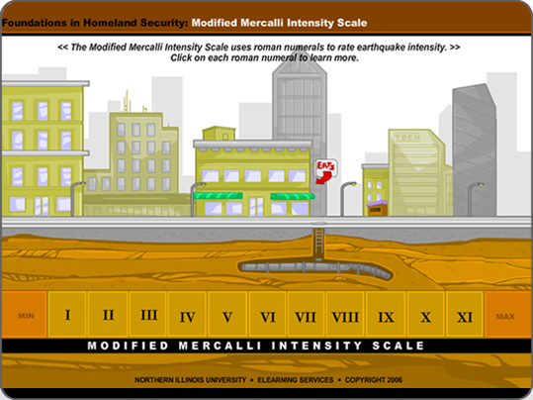
Assignment
Create a mini-poster, that illustrates the effects of an earthquake using the Mercalli scale for intensity (effects).

Slide 18
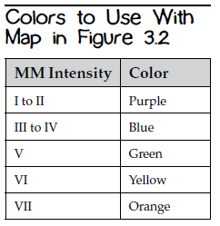
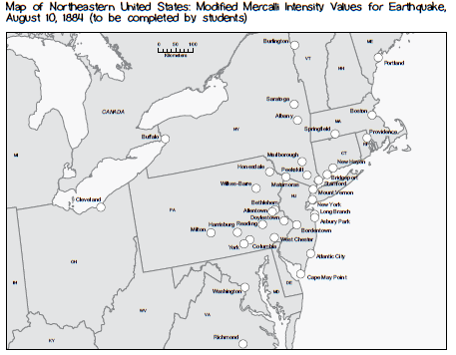
Task
Read articles with partners
Identify evidence
Note what is NOT in articles
Complete Data Table
Determine Modified Mercalli (MM) intensity
Use evidence from articles to determine
Come to group consensus
Be prepared to defend!
Mark map with MM Intensity & color using code

